Slide 1
8086 Microprocessor
Dr. Manju Khurana
Assistant Professor, CSED
TIET, Patiala
manju.khurana@thapar.edu

Slide 2
Features of 8086 microprocessor
It is a 16-bit, N-channel, HMOS (High speed metal oxide semiconductor) microprocessor.
Its CMOS (Complementary MOS) version, 80C86 is also available.
It consumes less power.
The 8086 draws 360 mA on 5V whereas the 80C86 draws only 10 mA.
8086 is manufactured for standard temperature range 32 F to 180 F as well as extended temperature range (40 F to +225 F).
Its clock frequencies for its different versions are: 5, 8 and 10 MHz.
It was introduced in 1978.

Slide 3
Features of 8086 microprocessor
It contains an electronic circuitry of 29000 transistors.
It is built on a single semiconductor chip and packaged on a 40-Pin IC package.
The type of package is DIP (Dual In-Line Package).
8086 uses 20 address lines and 16 data lines.
It can directly address up to 2^20=1Mbytes of memory.
The 16-bit data word is divided into a low-order byte and a high order byte.
The 16 low order address lines are time multiplexed with data, and the 4 high order address lines are time multiplexed with status signals.

Slide 4
Pin Diagram of Intel 8086 Microprocessor Mistake:- Pin 35 to 38 is A₁₆-A₁₉ instead of AD₁₆-AD₁₉.

Slide 5
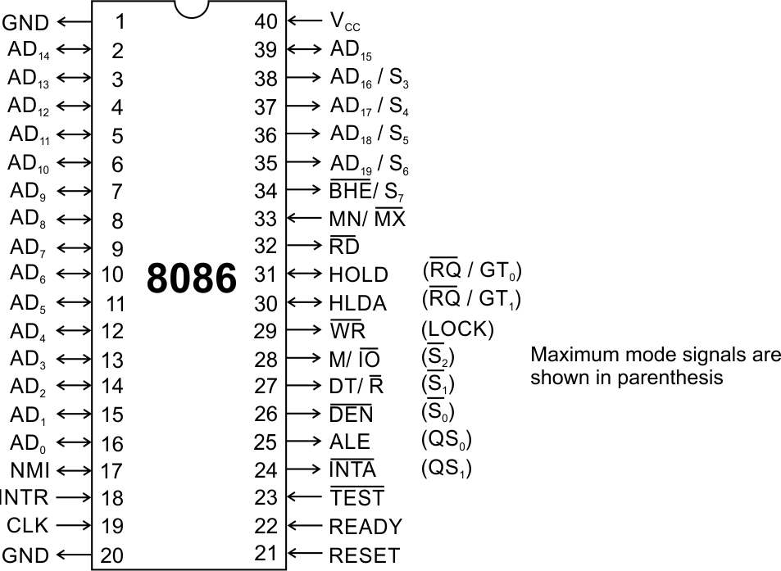
Pins and Signals
8086 Microprocessor
Common signals
AD₀-AD₁₅ (Bidirectional)
Address/Data bus
Low order address bus; these are multiplexed with data.
When AD lines are used to transmit memory address the symbol A is used instead of AD, for example A₀-A₁₅.
When data are transmitted over AD lines the symbol D is used in place of AD, for example D₀-D₇, D₈-D₁₅ or D₀-D₁₅.
A₁₆/S₃, A₁₇/S₄, A₁₈/S₅, A₁₉/S₆
High order address bus. These are multiplexed with status signals.
A₁₆ and A₁₇ are multiplexed with segment identifier signals S3 and S4.
A₁₈ multiplexed with interrupt status S5.
A₁₉ with status signal S6.

Slide 6
Pins and Signals
8086 Microprocessor
Common signals
BHE (Active Low)/S₇ (Output)
Bus High Enable/Status
(T1 is low)It is used to enable data onto the most significant half of data bus, D₈-D₁₅. 8-bit device connected to upper half of the data bus use BHE (Active Low) signal. It is multiplexed with status signal S₇.(S₇ available during T3 and T4.)
MN/ MX
MINIMUM / MAXIMUM
This pin signal indicates what mode the processor is to operate in.

Slide 7
Pins and Signals
8086 Microprocessor
BHE(low) A0 0 0 0 1 1 0 1 1 | Whole word is transferred Upper byte from/to odd address Lower byte from/to even address None
S₃, S_{4,} S₅
S3 and S4 identify the memory Segment which is being accessed.
S5 is Interrupt enable status.
For memory access, S₆ is always zero.

Slide 8
Pins and Signals
8086 Microprocessor
S3 S4 0 0 0 1 1 0 1 1 | ES SS CS DS

Slide 9
Pins and Signals
8086 Microprocessor
Common signals
TEST
TEST: input is examined by the ``Wait'' instruction. If the TEST input is LOW execution continues, otherwise the processor waits in an ``Idle'' state. This input is synchronized internally during each clock cycle on the leading edge of CLK.
used to synchronize an external activity to the processor internal operation.
RD (Read) (Active Low)
The signal is used for read operation.
It is an output signal.
It is active when low.

Slide 10
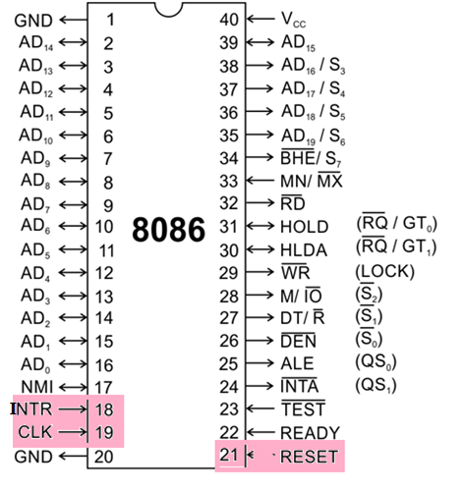
Pins and Signals
8086 Microprocessor
Common signals
RESET (Input)
Causes the processor to immediately terminate its present activity.
The signal must be active HIGH for at least four clock cycles.
CLK
The clock input provides the basic timing for processor operation and bus control activity.
5,8 or 10 MHz.
INTR Interrupt Request
This is a triggered input. This is sampled during the last clock cycles of each instruction to determine the availability of the request. If any interrupt request is pending, the processor enters the interrupt acknowledge cycle.
This signal is active high and internally synchronized.

Slide 11
Pins and Signals
8086 Microprocessor
Common signals
READY
This is the acknowledgement from the slow device(addressed I/O) or memory indicates that peripheral is ready to transfer data.
The signal made available by the devices is synchronized by the 8284A clock generator to provide ready input to the 8086.
The signal is active high.

Slide 12
Pins and Signals
8086 Microprocessor
Min/ Max Pins
The 8086 microprocessor can work in two modes of operations : Minimum mode and Maximum mode.
In the minimum mode of operation the microprocessor do not associate with any co-processors and can not be used for multiprocessor systems.
In the maximum mode the 8086 can work in multi-processor or co-processor configuration.
Minimum or maximum mode operations are decided by the pin MN/ MX(Active low).
When this pin is high 8086 operates in minimum mode otherwise it operates in Maximum mode.

Slide 13


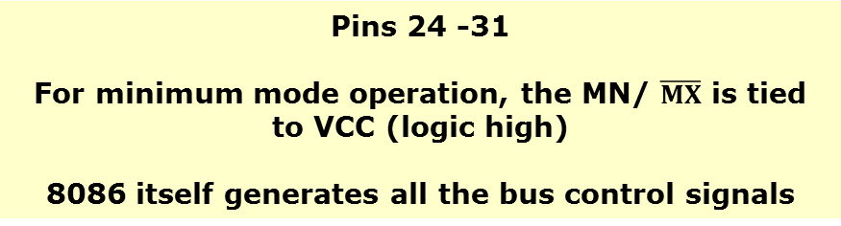

Pins and Signals
8086 Microprocessor
Minimum mode signals
Pins 24 -31
For minimum mode operation, the MN/ $\overline{MX}$ is tied to VCC (logic high)
8086 itself generates all the bus control signals
 | (Data Transmit/ Receive) Output signal from the processor to control the direction of data flow through the data transceivers.HIGH-data r sent out,LOW- received.
$$\overline{DEN}$$ | (Data Enable) Output signal from the processor used as out put enable for the transceivers
ALE | (Address Latch Enable) Used to demultiplex the address and data lines using external latches
M/$\overline{IO}$ | Used to differentiate memory access and I/O access. For memory reference instructions, it is high. For IN and OUT instructions, it is low.
$$\overline{WR}$$ | Write control signal; asserted low Whenever processor writes data to memory or I/O port
$$\overline{INTA}$$ | (Interrupt Acknowledge) When the interrupt request is accepted by the processor, the output is low on this line.

Slide 14
Pins and Signals
8086 Microprocessor
Minimum mode signals
Pins 24 -31
For minimum mode operation, the MN/ $\overline{MX}$ is tied to VCC (logic high)
8086 itself generates all the bus control signals
HOLD | Input signal to the processor form the bus masters as a request to grant the control of the bus. Usually used by the DMA controller to get the control of the bus.
HLDA | (Hold Acknowledge) Acknowledge signal by the processor to the bus master requesting the control of the bus through HOLD. The acknowledge is asserted high, when the processor accepts HOLD.

Slide 15
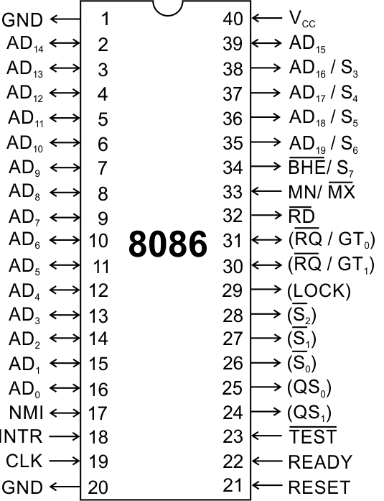
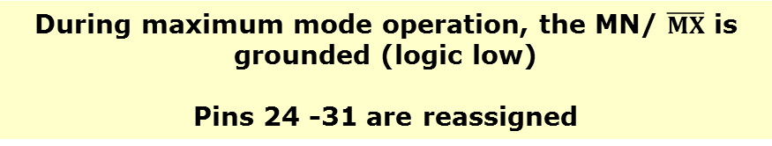
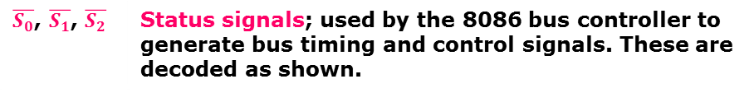
Pins and Signals
8086 Microprocessor
Maximum mode signals
During maximum mode operation, the MN/ $\overline{MX}$ is grounded (logic low)
Pins 24 -31 are reassigned
 | Status signals; used by the 8086 bus controller to generate bus timing and control signals. These are decoded as shown. Signals are connected to bus controller Intel 8288. It generates memory and I/O access control signals.

Slide 16
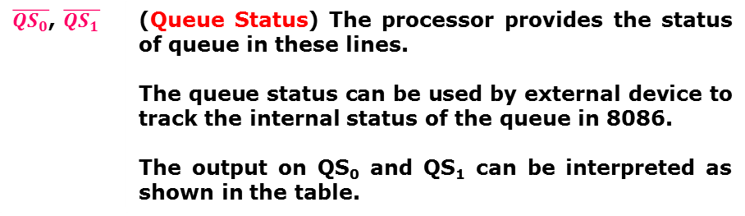
Pins and Signals
8086 Microprocessor
Maximum mode signals
During maximum mode operation, the MN/ $\overline{MX}$ is grounded (logic low)
Pins 24 -31 are reassigned
$\overline{{QS}_{0}}$, $\overline{QS_{1}}$ | (Queue Status) The processor provides the status of queue in these lines. The queue status can be used by external device to track the internal status of the queue in 8086. The output on QS₀ and QS₁ can be interpreted as shown in the table.

Slide 17
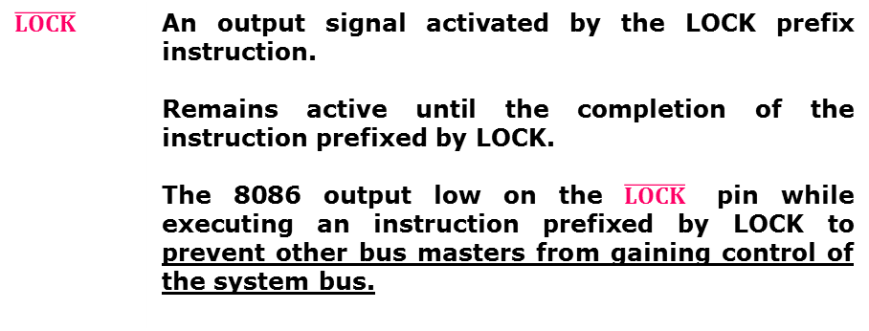
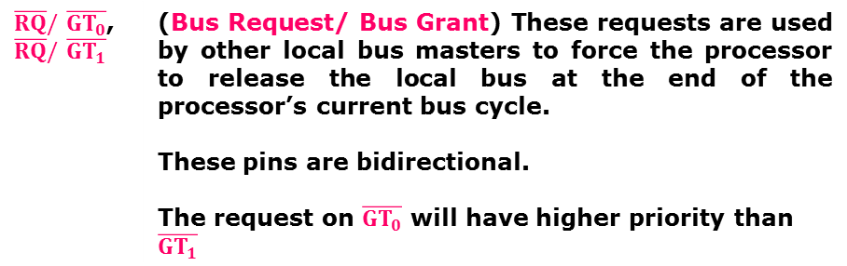
Pins and Signals
8086 Microprocessor
Maximum mode signals
During maximum mode operation, the MN/ $\overline{MX}$ is grounded (logic low)
Pins 24 -31 are reassigned
$\overline{RQ}/$$\overline{GT_{0}}$, $\overline{RQ}/$$\overline{GT_{1}}$ | (Bus Request/ Bus Grant) These requests are used by other local bus masters to force the processor to release the local bus at the end of the processor’s current bus cycle. These pins are bidirectional. The request on$\overline{GT_{0}}$ will have higher priority than$\overline{GT_{1}}$
$$\overline{LOCK}$$ | An output signal activated by the LOCK prefix instruction. Remains active until the completion of the instruction prefixed by LOCK. The 8086 output low on the $\overline{LOCK}$ pin while executing an instruction prefixed by LOCK to prevent other bus masters from gaining control of the system bus.

Slide 18
Pins and Signals
8086 Microprocessor
Maximum mode signals
During maximum mode operation, the MN/ $\overline{MX}$ is grounded (logic low)
Pins 24 -31 are reassigned
WR(LOW) ALE DEN(LOW) DT/R(LOW) | Not available directly from the processor. These signals are available from the controller 8288.

Slide 19


